Slide 1
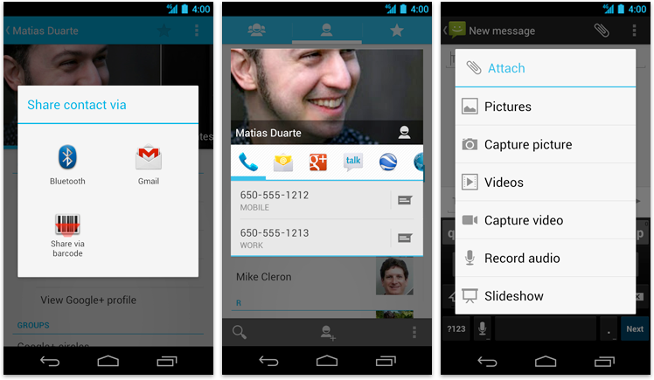
Notifications

Slide 2
Types of Notifications
Toast Notification – Shows message that fades away after a few seconds. (Background type also)
Alert/Dialog Notification – Shows dialog notification message and displayed till user action is performed.
Status Notification – Comes out of an active Activity.

Slide 3
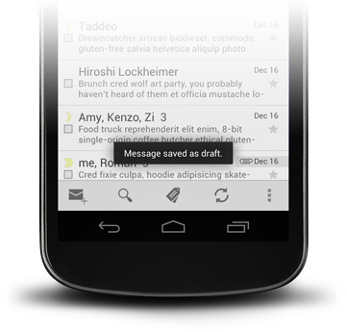
Toasts
Small popup
Automatically disappear
Timeout :TOAST_LONG / TOAST_SHORT
Toast.makeText(getApplicationContext(),
"Message saved as draft, Toast.LENGTH_LONG).show();

Slide 4
Alert Dialog
Android AlertDialog can be used to display the dialog message with OK and Cancel buttons.
It can be used to interrupt and ask the user about his/her choice to continue or discontinue.
Android AlertDialog is composed of three regions: title, content area and action buttons.

Slide 5
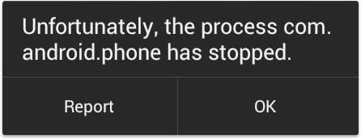
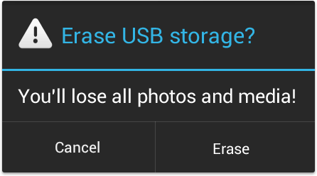
Alerts
Alerts without title bar
Alerts with title bar

Slide 6

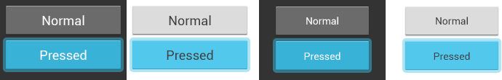
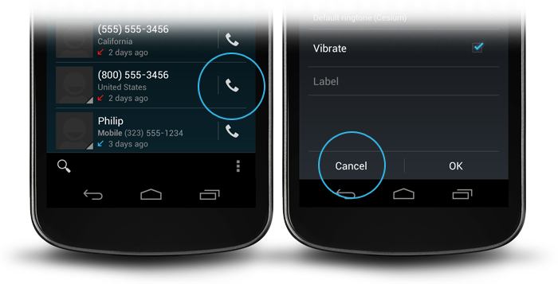
Buttons
Buttons
Basic Buttons
Borderless Buttons

Slide 7
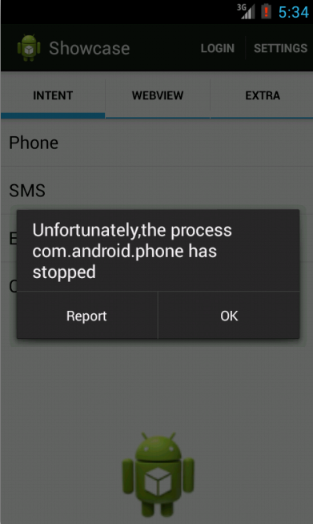

AlertDialog : Alerts without title bar
public void showAlert(){
AlertDialog.Builder builder = new AlertDialog.Builder(wrapper);
builder.setMessage("Unfortunately,the process com.android.phone has stopped"); builder.setPositiveButton("OK",null);
builder.setNegativeButton("Report", new DialogInterface.OnClickListener() { @Override
public void onClick(DialogInterface dialog, int which) {
//show Report Activity
}
});
builder.create().show();
}

Slide 8
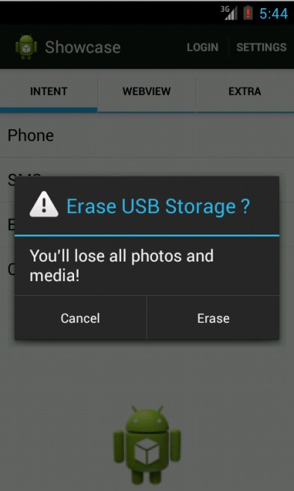
AlertDialog : Alerts with title bar
public void showAlertWithTitleBar(){
AlertDialog.Builder builder = new AlertDialog.Builder(wrapper); builder.setIcon(android.R.drawable.ic_dialog_alert); builder.setTitle("Erase USB Storage ?"); builder.setMessage("You’ll lose all photos and media!");
builder.setPositiveButton("Erase", new DialogInterface.OnClickListener() { @Override
public void onClick(DialogInterface dialog, int which) {
//do Report Activity
}
});
builder.setNegativeButton("Cancel", null); builder.create().show();
}

Slide 9
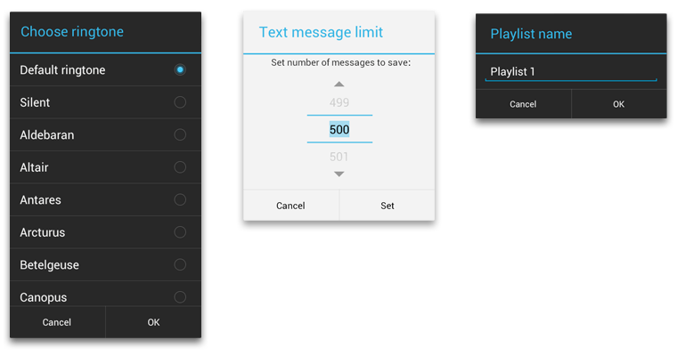
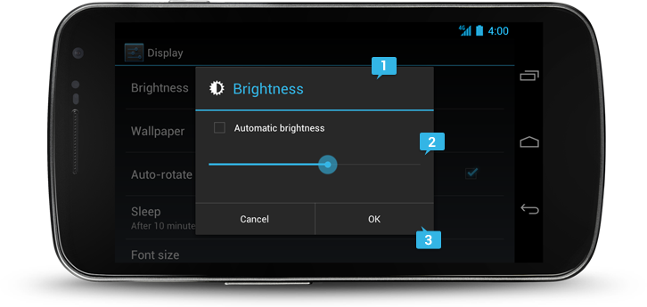
Dialogs
Optional Title
Content area
Action button

Slide 10
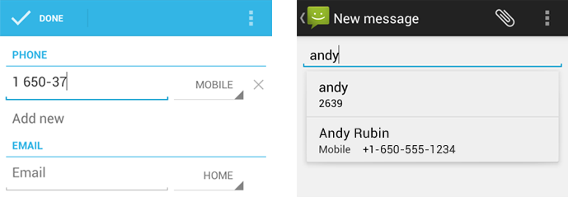
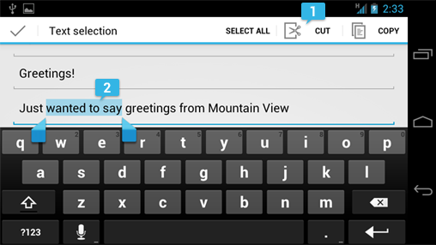
Text Fields : EditText
Single line & Multi line
Text field types
Text selection

Slide 11
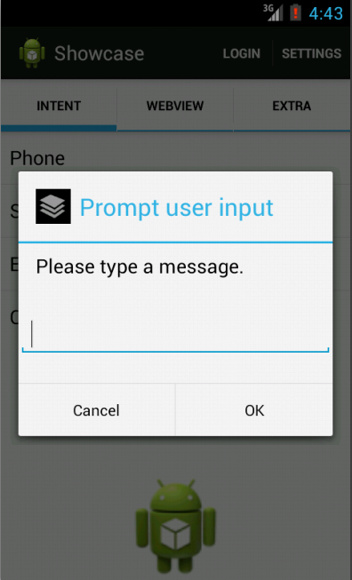
AlertDialog : Prompt user input
AlertDialog.Builder builder = new AlertDialog.Builder(this);
builder.setIcon(R.drawable.ic_layer); builder.setTitle("Prompt user input"); builder.setMessage("Please type a message.");
// Set an EditText view to get user input final EditText input = new EditText(this); builder.setView(input);
builder.setPositiveButton("OK", new DialogInterface.OnClickListener() { @Override
public void onClick(DialogInterface dialog, int which) { Log.i("AlertDialog","input text =" + input.getText().toString());
}
});
builder.setNegativeButton("Cancel", new DialogInterface.OnClickListener() { @Override
public void onClick(DialogInterface dialog, int which) {
}
});
builder.create().show();
}

Slide 12
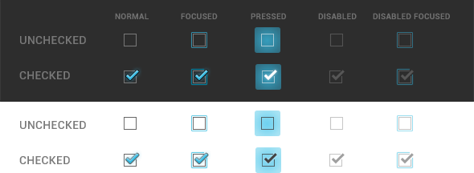
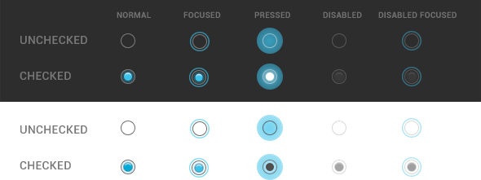
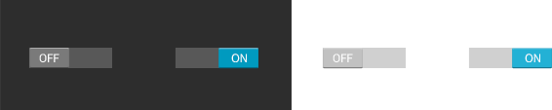
Switches
Checkboxes
Radio Buttons
On/Off Switches

Slide 13
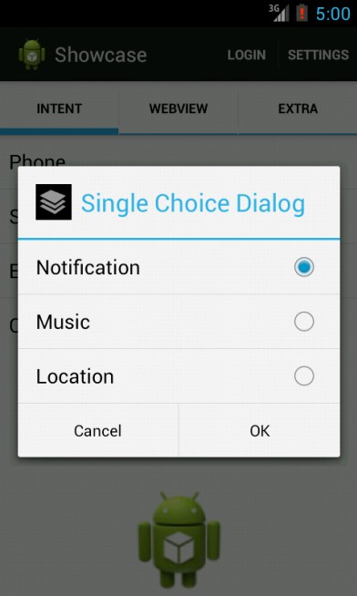
AlertDialog : Single choice dialog
String[] items = {"Notification", "Music", "Location"}; boolean[] itemsChecked = new boolean[items.length];
AlertDialog.Builder builder = new AlertDialog.Builder(this); builder.setIcon(R.drawable.ic_layer); builder.setTitle("Multi Choice Items"); builder.setPositiveButton("OK",
new DialogInterface.OnClickListener() { @Override
public void onClick(DialogInterface dialog, int which) {
}
});
builder.setNegativeButton("Cancel",
new DialogInterface.OnClickListener() { @Override
public void onClick(DialogInterface dialog, int which) {
}
});
builder.setSingleChoiceItems(items,-1,
new DialogInterface.OnClickListener() { @Override
public void onClick(DialogInterface dialog, int item) {
}
});
builder.create().show();
}

Slide 14
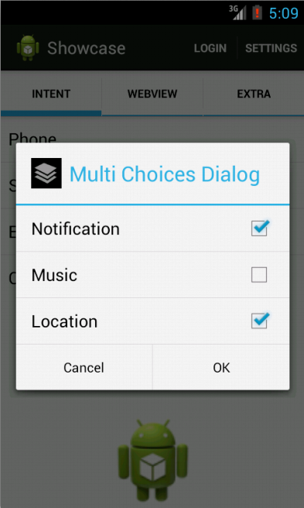
AlertDialog : Multi choices dialog
String[] items = {"Notification", "Music", "Location"}; boolean[] itemsChecked = new boolean[items.length];
AlertDialog.Builder builder = new AlertDialog.Builder(this); builder.setIcon(R.drawable.ic_layer); builder.setTitle("Multi Choices Dialog"); builder.setPositiveButton("OK",
new DialogInterface.OnClickListener() { @Override
public void onClick(DialogInterface dialog, int which) {
}
});
builder.setNegativeButton("Cancel",
new DialogInterface.OnClickListener() { @Override
public void onClick(DialogInterface dialog, int which) {
}
});
builder.setMultiChoiceItems(items, itemsChecked,
new DialogInterface.OnMultiChoiceClickListener() { @Override
public void onClick(DialogInterface dialog, int which, boolean isChecked) {
}
});
builder.create().show();
}

Slide 15
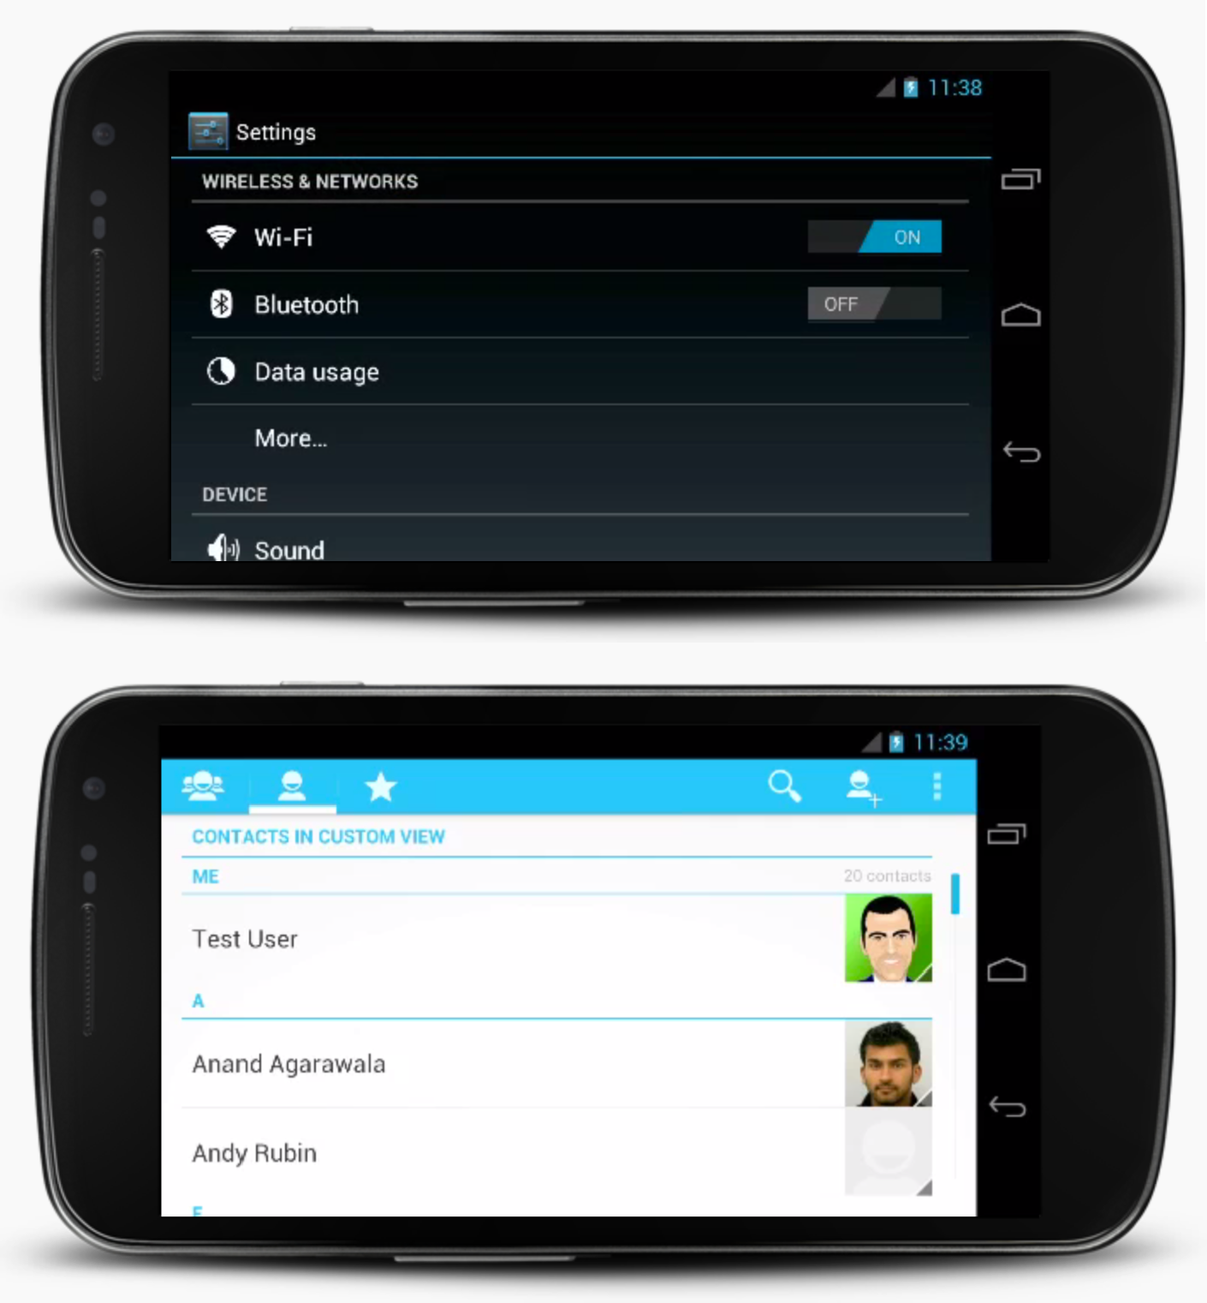
Scrolls
Scroll Indicator
Index Scrolling

Slide 16
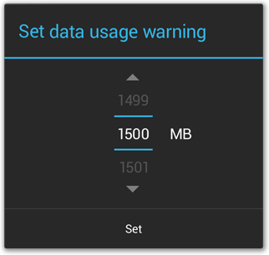
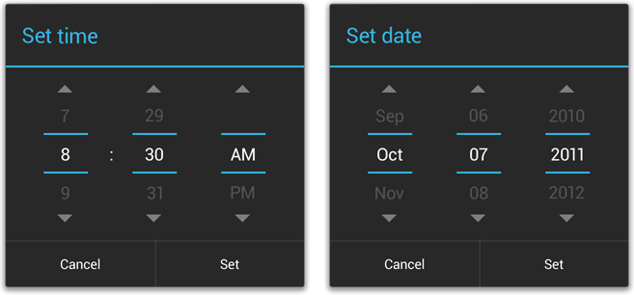
Pickers
Space considerations
Date & Time pickers

Slide 17
Popups (>API 11)

Slide 18
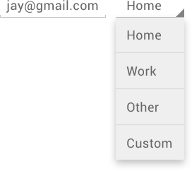
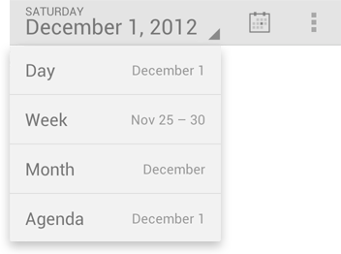
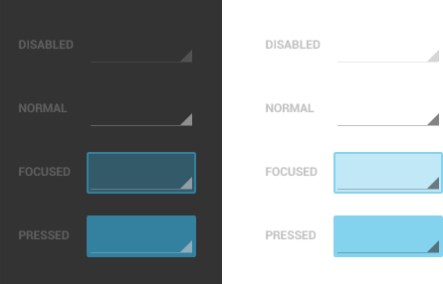
Spinners
Spinners in action bars
(>API 11)
Spinners in forms

Slide 19
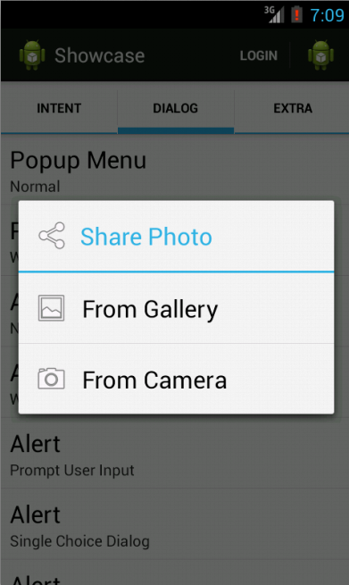
AlertDialog : Popup Menu With Icon
public void showPopupMenuWithIcon(){
final String [] items = new String[] {"From Gallery", "From Camera"}; final Integer[] icons = new Integer[] {android.R.drawable.ic_menu_gallery,
android.R.drawable.ic_menu_camera};
ListAdapter adapter = new ArrayAdapterWithIcon(this, items, icons); ContextThemeWrapper wrapper = new ContextThemeWrapper(this,
android.R.style.Theme_Holo_Light_Dialog);
AlertDialog.Builder builder = new AlertDialog.Builder(wrapper); builder.setIcon(android.R.drawable.ic_menu_share); builder.setTitle("Share Photo");
builder.setAdapter(adapter, new DialogInterface.OnClickListener() {
public void onClick(DialogInterface dialog, int item) {
//...
}
});
builder.create().show();
}

Slide 20
ArrayAdapterWithIcon.java
public class ArrayAdapterWithIcon extends ArrayAdapter<String> {
private List<Integer> images;
public ArrayAdapterWithIcon(Context context, List<String> items, List<Integer> images) { super(context, android.R.layout.select_dialog_item, items);
this.images = images;
}
public ArrayAdapterWithIcon(Context context, String[] items, Integer[] images) { super(context, android.R.layout.select_dialog_item, items);
this.images = Arrays.asList(images);
}
@Override
public View getView(int position, View convertView, ViewGroup parent) { View view = super.getView(position, convertView, parent);
TextView textView = (TextView) view.findViewById(android.R.id.text1); textView.setCompoundDrawablesWithIntrinsicBounds(images.get(position), 0, 0, 0); textView.setCompoundDrawablePadding(
(int) TypedValue.applyDimension(TypedValue.COMPLEX_UNIT_DIP, 12,
getContext().getResources().getDisplayMetrics()));
return view;
}
}

Slide 21
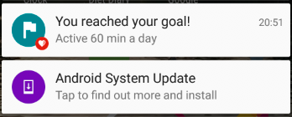
What is a status bar notification?
Message displayed to user outside regular app UI
Small icon
Title
Detail text

Slide 22
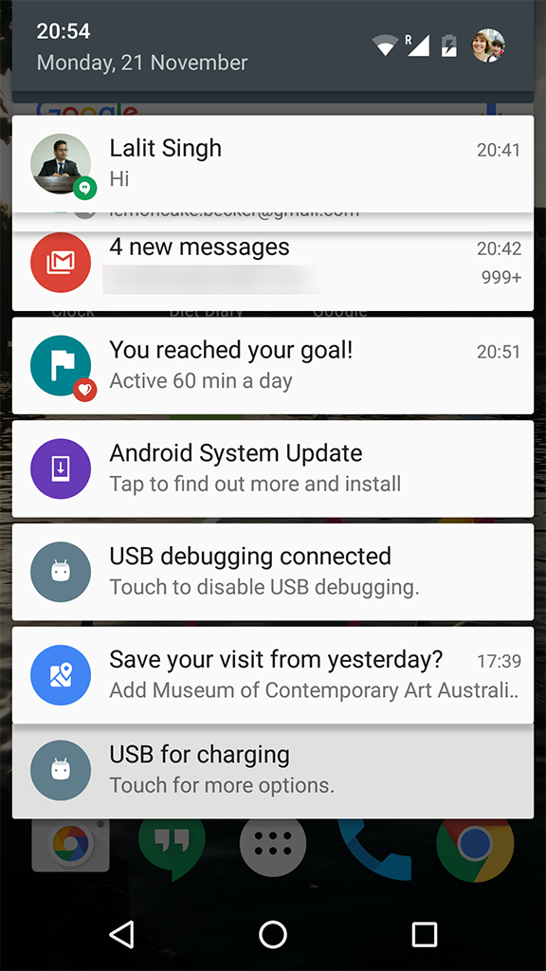
How are notifications used?
Android issues a notification that appears as icon
To see details, user opens the notification drawer
User can view notifications any time in the notification drawer

Slide 23
Building a Notification
Two classes
NotificationCompat.Builder
Specifies UI and actions
NotificationCompat.Builder.build() creates the Notification
NotificationManager / NotificationManagerCompat
NotificationManager.notify() issues the notification

Slide 24
Building a Notification
Define variables
private NotificationCompat.Builder mNotifyBuilder;
private NotificationManager mNotifyManager;
private static final int NOTIFICATION_ID = 0

Slide 25
Building a Notification
Instantiate NotificationManager
In onCreate() of activity
mNotifyManager = (NotificationManager)getSystemService(NOTIFICATION_SERVICE);

Slide 26
Building a Notification
Build and send notification basic model
Define notification and set required attributes
mNotifyBuilder = new NotificationCompat.Builder(this,channel_id)
.setContentTitle("You've been notified!")
.setContentText("This is your notification text.")
.setSmallIcon(R.drawable.ic_android_black_24dp);
Notification myNotification = mNotifyBuilder.build();
mNotifyManager.notify(NOTIFICATION_ID, myNotification);

Slide 27
if(Build.VERSION.SDK_INT>Build.VERSION_CODES.O) //for version control greater than oreo { NotificationChannel notificationChannel=new NotificationChannel("anu","Anupama",NotificationManager.IMPORTANCE_DEFAULT); NotificationManager notificationManager= (NotificationManager) getSystemService(getApplicationContext().NOTIFICATION_SERVICE); notificationManager.createNotificationChannel(notificationChannel); }
notificationManagerCompat=NotificationManagerCompat.from(MainActivity.this); b1.setOnClickListener(new View.OnClickListener() { @Override public void onClick(View v) { builder=new NotificationCompat.Builder(MainActivity.this,"anu"); builder.setSmallIcon(R.drawable.a); builder.setContentTitle("whatsapp notifications"); builder.setContentText("You got a notification from anu"); Notification notification=builder.build(); notificationManagerCompat.notify(NOTIFICATION_ID,notification); } });

